Slide 1
AI Job Market Dashboard
Interactive Analytics & Job Search Platform
Name: Garima Agrawal
Course: Msc Big Data and AI
Subject: Big Data And Business Intelligence
University: SRH Campus Leipzig

Slide 2
📋 Project Overview
Build an interactive dashboard to explore AI and Data Science job market trends with powerful filtering and visualization capabilities.
Provides comprehensive insights into AI and Data Science jobs (2024-2025)
Purpose:
• Enable data-driven job search decisions
• Identify market trends in AI/Data Science roles
• Support career planning with real market data
Dataset: 12,000+ AI/Data Science job listings

Slide 3
🎯 Target Audience
1. Job Seekers
• Data Scientists seeking new opportunities
• AI Engineers exploring career options
• Career switchers entering AI/Data fields
2. HR Professionals & Recruiters
• HR analysts researching competitive positioning
• Recruitment agencies specializing in tech roles
3. Market Researchers & Analysts
• Labor market analysts and career counselors
• Educational institutions for curriculum planning
• Business strategists analyzing AI talent trends

Slide 4

📊 KPI #1: Job Market Coverage
Metric: Total number of unique job listings tracked
Current Value: 12,000+ AI/Data Science positions
Target: Maintain 90%+ data accuracy and freshness
Business Impact: opportunities across multiple dimensions (location, experience, remote status, job titles)

Slide 5

📊 KPI #2: Filter Utilization Rate
Metric: Percentage of users actively using 2+ filters
Current Target: 75% user engagement with filtering
Measurement:
Track filter combinations (location + experience + remote status)
Business Impact: Higher filter usage indicates users are finding relevant, personalized results that match their specific needs
Success Indicator: Users spending more time on filtered views and returning for multiple sessions

Slide 6

📊 KPI #3: Data Export Engagement
Metric: Number of data downloads per session
Target: 40% of users export filtered data
Success Indicator: Users finding value in taking data for further analysis
Business Impact: Demonstrates dashboard utility for decision-making workflows Shows users trust the data quality for external use Indicates integration into professional workflows
Tracking: Export button clicks and file generation counts

Slide 7
✨ Core Features
🏠 Overview Dashboard
Quick statistics and key metrics at a glance
Active filter summary and market insights
🔍 Job Search
Browse 50+ listings with applied filters
View essential job details (title, company, location)
📊 Top Job Titles
Visual ranking of in-demand roles
Interactive charts and detailed tables
🧭 Data Explorer
Custom column selection for personalized views
Full dataset access and CSV download

Slide 8
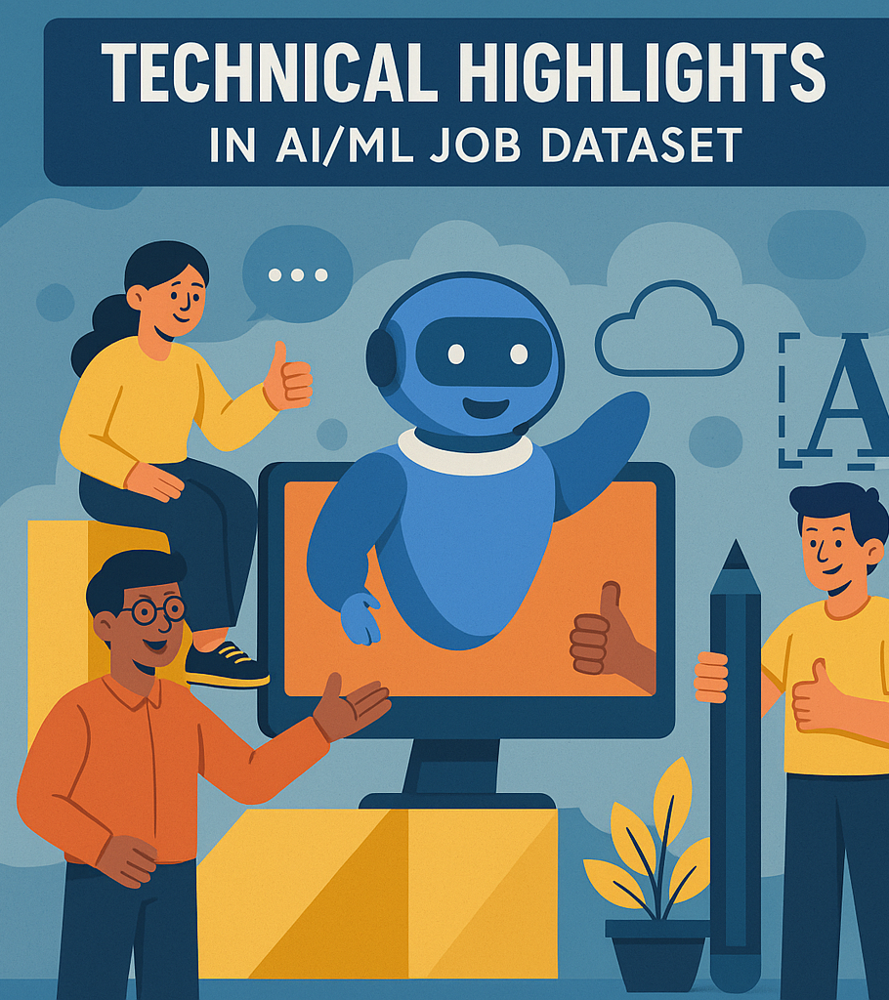
Technical Highlights
Technology Stack:
Frontend: Streamlit (Python)
Data Processing: Pandas, NumPy
Visualization: Plotly, Altair
Styling: Custom CSS with modern gradients
Key Capabilities:
Dynamic Filtering System
Responsive design for various screen sizes
Performance optimized with @st.cache_data
Export functionality for downstream analysis
Modern UI/UX:
Gradient color schemes (purple/blue)
Interactive hover effects and smooth transitions
Emoji navigation for better user experience

Slide 9
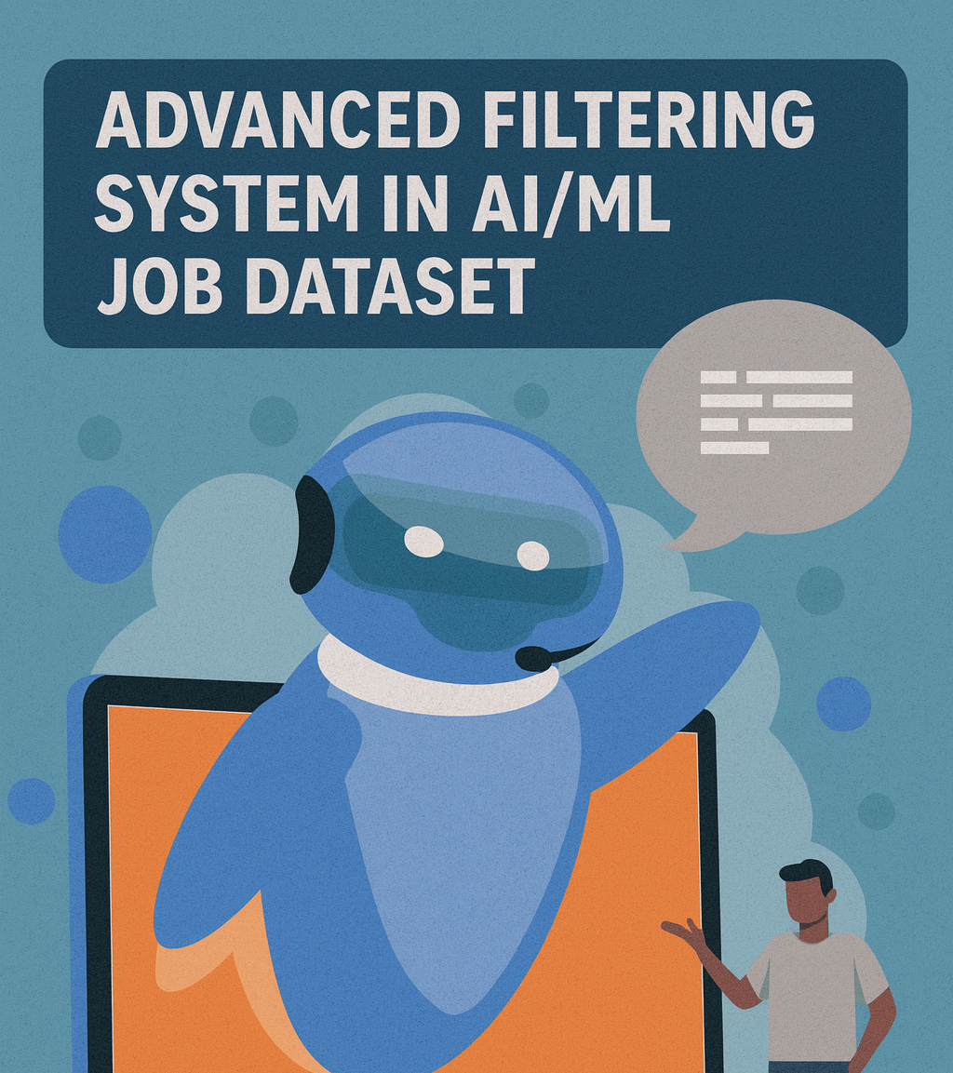
Advanced Filtering System
💼 Job Title - Target specific roles (Data Scientist,
AI Engineer, ML Engineer, etc.)
📍 Location - Filter by country (50+ countries available)
🎓 Experience Level - Match your career stage (Entry,
Mid-Level, Senior, Executive)
🏡 Remote Ratio - Find your preferred work style
• 0% = Onsite
• 50% = Hybrid
• 100% = Fully Remote
Smart Defaults: Pre-configured for popular searches
(Germany location, Mid-level experience, Fully remote)

Slide 10

📈 Business Value Proposition
For Job Seekers:
Save Time: Filter 12,000+ jobs to relevant matches in seconds
Make Informed Decisions: Compare opportunities across dimensions
Track Trends: Understand what roles are most in-demand
For HR/Recruiters:
Market Intelligence: Benchmark requirements and positioning
Talent Mapping: Identify where candidates are located
Competitive Analysis: Track trending skills and job titles
For Researchers:
Data Access: Export filtered datasets for deep analysis
Trend Analysis: Visualize market dynamics over time
Evidence-Based Insights: Make recommendations backed by data

Slide 11
🚀 Real-World Use Cases
Use Case 1: Career Transition Planning
Software engineer transitioning into AI/ML roles
→ Filter for ML Engineer + Entry/Mid-level roles
→ Review required skills and identify skill gaps
→ Export data to track applications over time
Use Case 2: Recruitment Strategy
HR team needs to hire Data Scientists in Europe
→ Filter location to European countries
→ Analyze top companies hiring similar roles
→ Export competitive intelligence data for team review
Use Case 3: Market Research
Analyst studying AI job market trends for report
→ Compare job titles across regions and experience levels
→ Analyze remote vs. onsite distribution patterns
→ Generate comprehensive reports from exported data

Slide 12

Thank You!
Scan to connect

